Slide 1

Module 3
Classes and Objects

Slide 2
Content (slot 2)
The Circle Problem Revisited
The Circle Problem in Unity Revisited
Putting It All Together in a Console App
Putting It All Together in a Unity Script
Common Mistakes

Slide 3
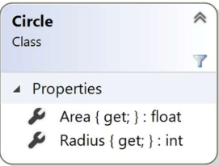
The Circle Problem Revisited
The problem description:
Calculate the area of the circles with integer radii from 0 to 5, then print out the radius and area for each circle.
Understand the Problem
The problem hasn’t changed, so you should still understand it.
Design a Solution

Slide 4
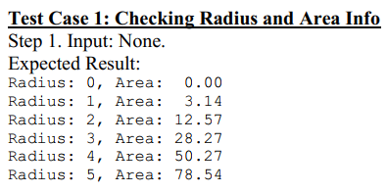
The Circle Problem Revisited
Write Test Cases:
Test case is exactly the same as it was in the previous chapter.

Slide 5
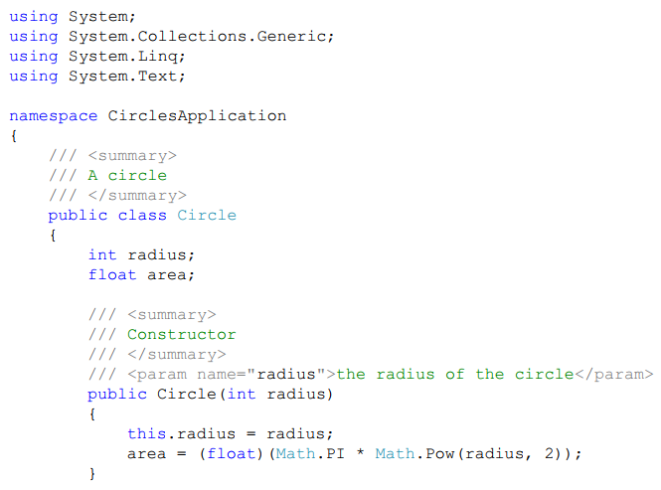
The Circle Problem Revisited
Write the Code:

Slide 6

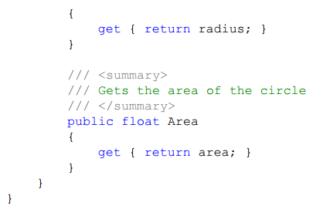
The Circle Problem Revisited
Write the Code:

Slide 7
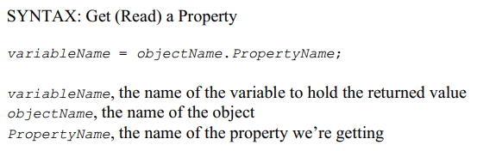
The Circle Problem Revisited
Write the Code:

Slide 8
The Circle Problem Revisited
Write the Code:

Slide 9
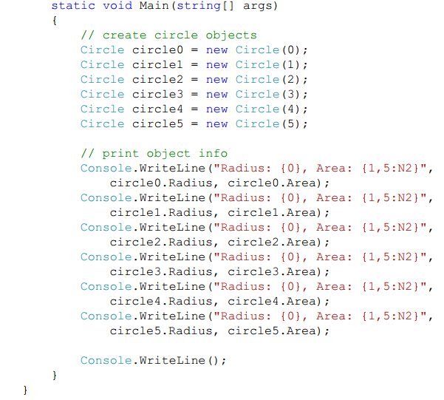
The Circle Problem Revisited
Write the Code:

Slide 10
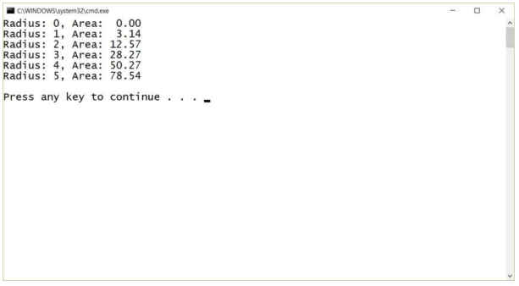
The Circle Problem Revisited
Test the Code:

Slide 11
The Circle Problem Revisited
Test the Code:
Test Case 1: Checking Radius and Area Info Results

Slide 12
The Circle Problem in Unity Revisited
Problem description:
Display circles with integer radii from 1 to 5 in the game window, with each circle displaying its own radius and area in the Console window.
Understand the Problem:
First, we removed the circle with a radius of 0 because a circle with a 0 radius will be pretty hard to see!
Second, the problem description says to display the circles “in the game window”.
Design a Solution:
Write a new Circle script and implement the required functionality in the Start method in that script.

Slide 13
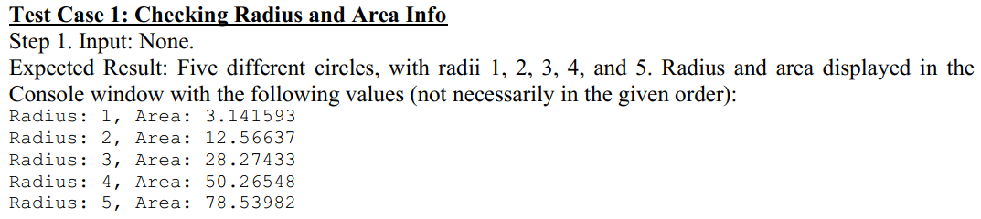
The Circle Problem in Unity Revisited
Write Test Cases:

Slide 14
The Circle Problem in Unity Revisited
Write the Code:
Our Circle script will be significantly different from the Circle class we wrote in the previous section because we need to make lots of changes to make things work properly in Unity.
Look at our Circle game object in the Unity editor.
Our Circle game object has a Transform component, a Sprite Renderer component, and the Circle script we added as a component.

Slide 15
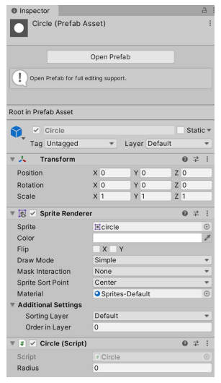
The Circle Problem in Unity Revisited
Write the Code:
Circle Object in Inspector

Slide 16
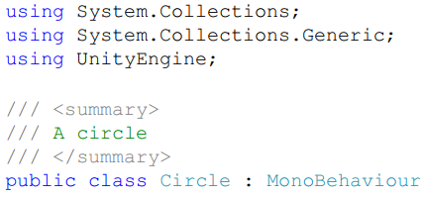
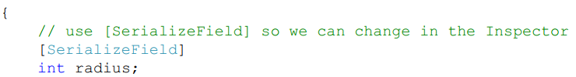
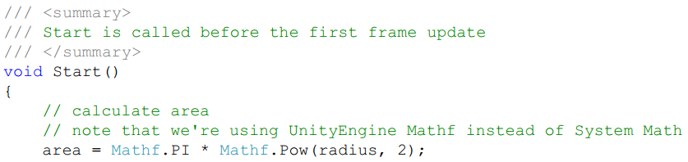
The Circle Problem in Unity Revisited
Write the Code:

Slide 17
The Circle Problem in Unity Revisited
Write the Code:
The UnityEngine namespace contains a Mathf class that essentially provides all the functionality of the Math class in the System namespace, but using floats instead of doubles.
To scale the displayed circle based on its radius, a transform is used to read and set (write) the position, rotation, and scale of an object in the game world.
Look at the documentation for the Transform class in the Unity Scripting Reference.

Slide 18
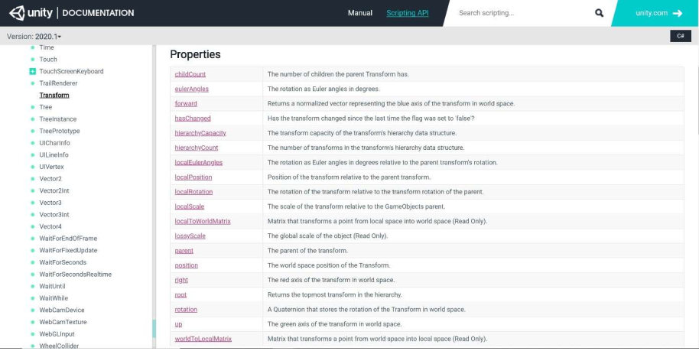
The Circle Problem in Unity Revisited
Write the Code:

Slide 19
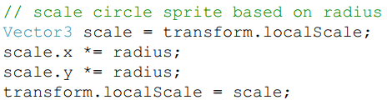

The Circle Problem in Unity Revisited
Write the Code:
Each Vector3 object has x, y, and z properties for the vector.
we don't have to modify the z component of the vector because we're working in 2D in this Unity project.

Slide 20
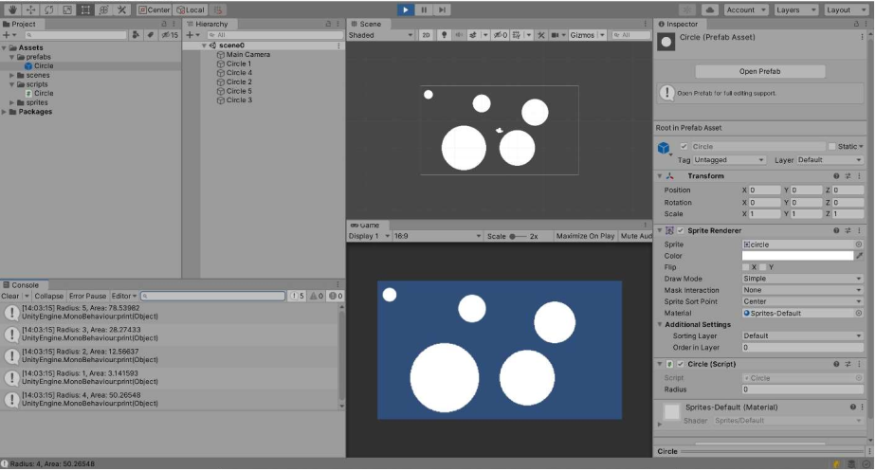
The Circle Problem in Unity Revisited
Test the Code: Test Case 1: Checking Radius and Area Info Results

Slide 21
Putting It All Together in a Console App
The problem description:
Create three cards with ranks and suits of your choosing, then print out the ranks and suits of those cards in reverse order.
Understand the Problem:
What does “reverse order” mean? let's assume that means we print the last card we created first, then the second card we created, and finally the first card.
Pick the ranks and suits: the Ace of Spades, the Jack of Diamonds, and the Queen of Hearts.
Design a Solution:
Using an application class that creates the three cards, then prints the pertinent information in reverse order.

Slide 22
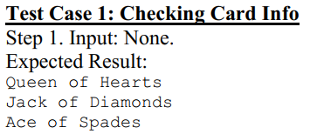
Putting It All Together in a Console App
Write Test Cases:
assumption here – that the Card class has already been tested, so we don't have to test it again here.

Slide 23
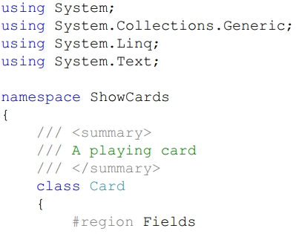
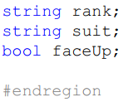
Putting It All Together in a Console App
Write the Code:
Card Class

Slide 24
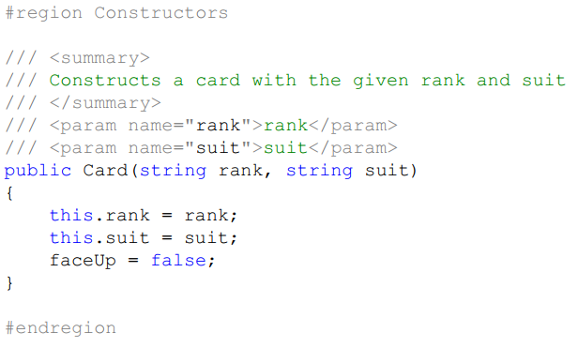
Putting It All Together in a Console App
Write the Code:

Slide 25
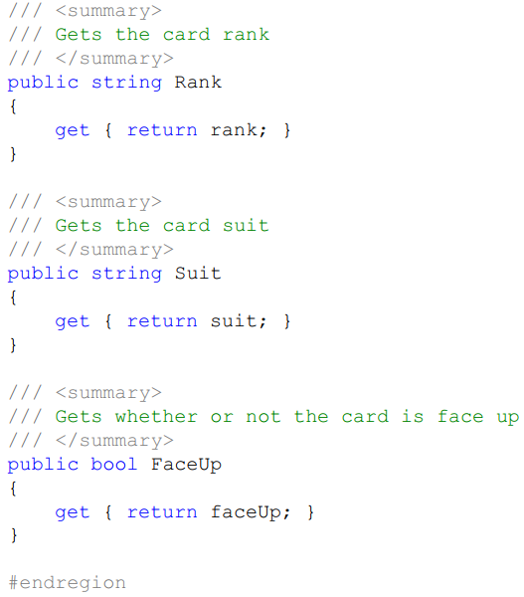
Putting It All Together in a Console App
Write the Code:

Slide 26
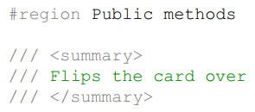
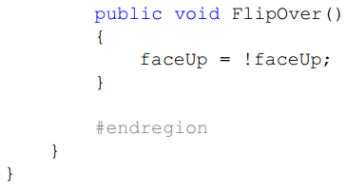
Putting It All Together in a Console App
Write the Code:

Slide 27
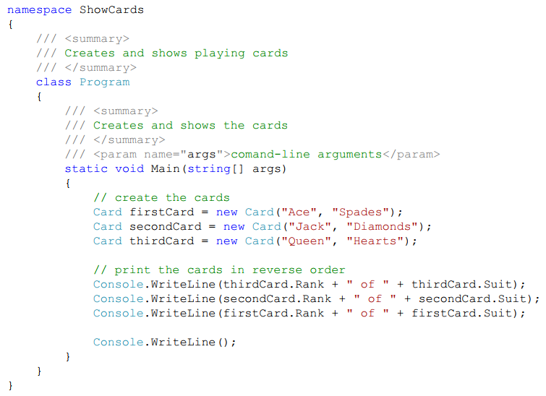
Putting It All Together in a Console App
Write the Code: Application class

Slide 28
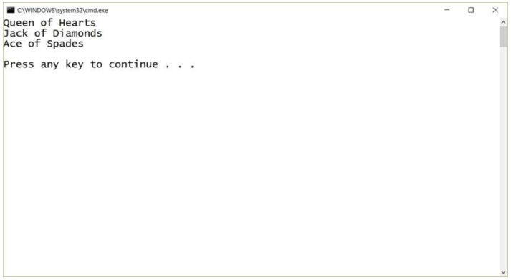
Putting It All Together in a Console App
Test the Code

Slide 29
Putting It All Together in a Unity Script
The problem description:
Create three cards with ranks and suits of your choosing, then display the three cards, face up, on the screen.
Understand the Problem: pretty straightforward
Design a Solution:
develop a Card script that includes access to strings for the rank and suit of the card as well as the ability to flip the card over.

Slide 30
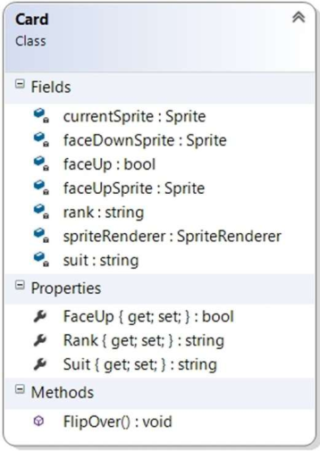
Putting It All Together in a Unity Script
Design a Solution: UML for Card Script

Slide 31
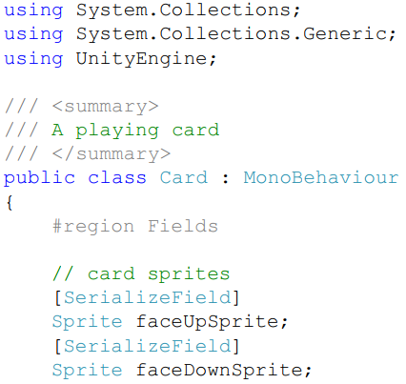
Putting It All Together in a Unity Script
Write Test Cases:
Write the Code

Slide 32
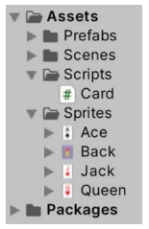
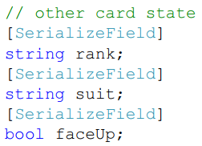

Putting It All Together in a Unity Script
Write the Code
Project window

Slide 33
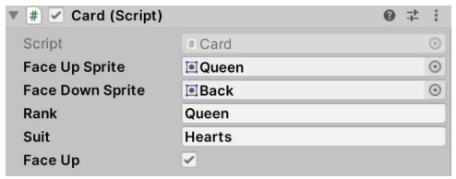
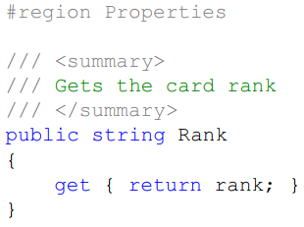
Putting It All Together in a Unity Script
Write the Code:
Inspector

Slide 34
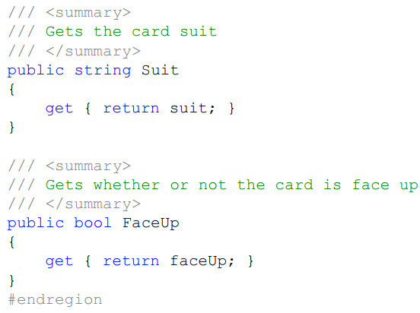
Putting It All Together in a Unity Script
Write the Code:

Slide 35
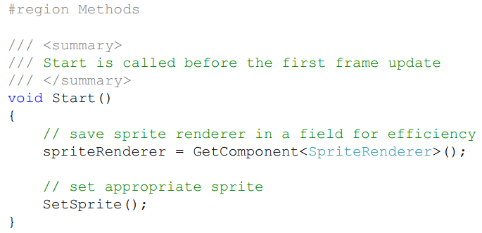
Putting It All Together in a Unity Script
Write the Code:

Slide 36
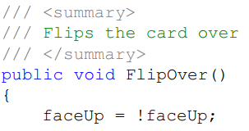

Putting It All Together in a Unity Script
Write the Code:

Slide 37
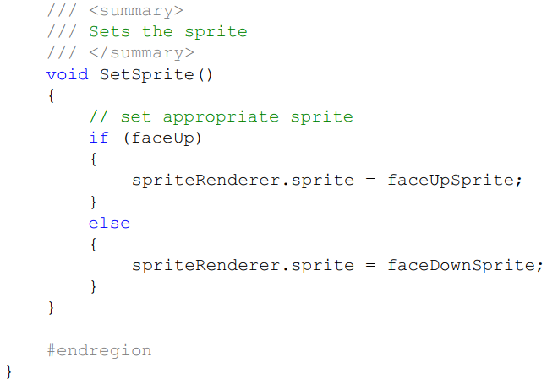
Putting It All Together in a Unity Script
Write the Code:

Slide 38
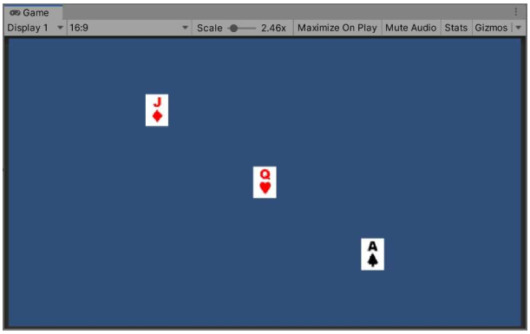
Putting It All Together in a Unity Script
Test the Code:
Test Case 1: Checking Card Display

Slide 39
Common Mistakes
Trying to Use an Object Before It's Created
Adding Parentheses After the Property Name
Forgetting the Parentheses After the Method Name

Slide 40
Summary
Classes and Objects
Calling Methods
Common Mistakes

